Slide 1

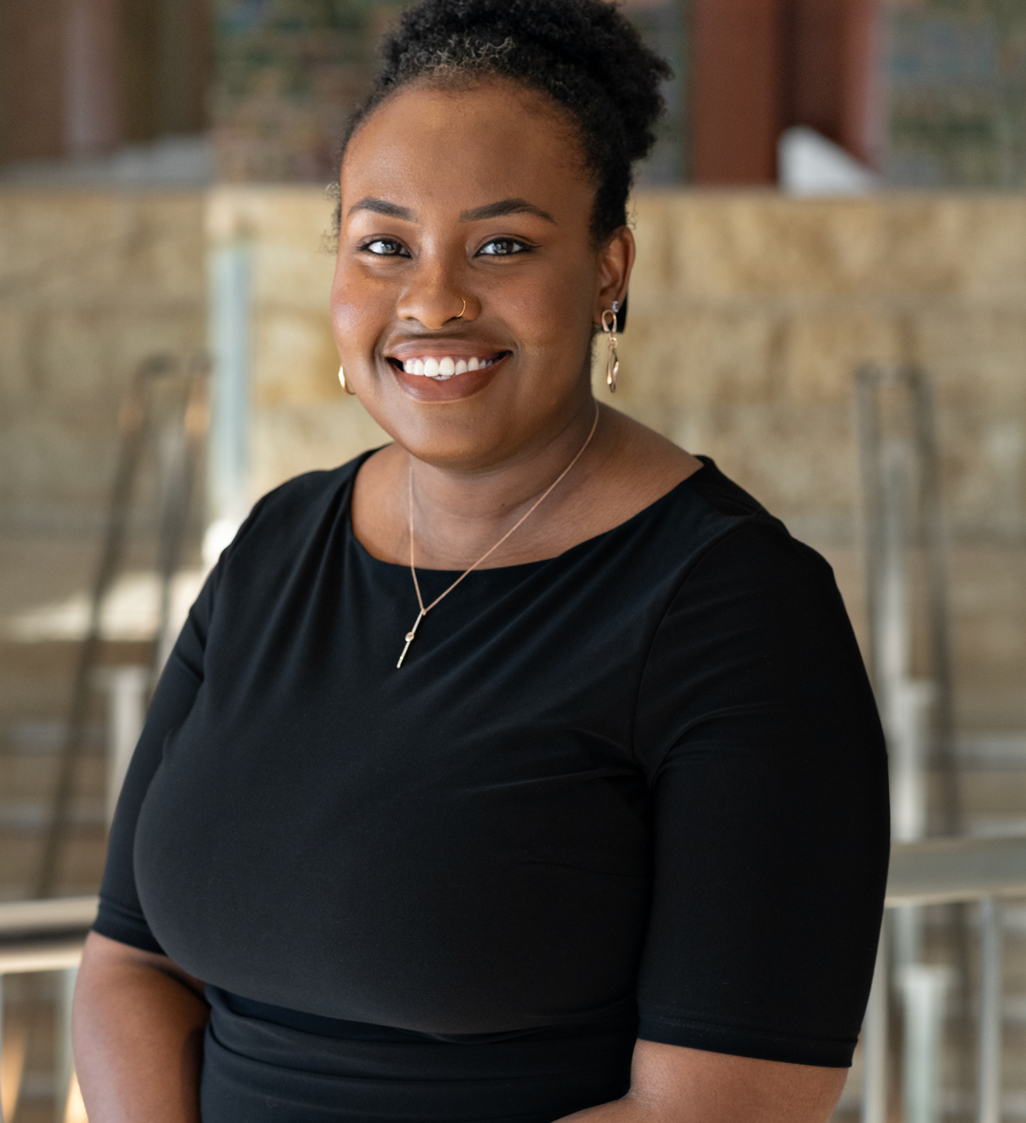

Applied Economics (APEC) Student Seminar
Monique Davis
APEC PhD
Wednesday
November 6
11 AM – 12 PM
Ruttan Hall 119
https://umn.zoom.us/j/97280645601
Title:
Safety for Whom? How Law Enforcement and School Resource Officer Training Impacts Racial Gaps in School Exclusionary

